Slide 1


Biography
President and CEO of CorePower Magnetics
Commercializing novel inductor, transformer, and motor technology based on nanocrystalline alloys
Prior industry experience
Designed and led teams developing new alloys in austenitic stainless steels, Ni-base alloys, and soft magnetics
Led Product Engineering and Product Compliance groups for the $2B specialty alloy business unit. Accountable for engineering and continuous improvement for 15,000 SKUs serving 7 markets including aerospace, transportation, and energy.
Education:
B.S. in Materials Science and Engineering from Penn State University
M.S. & Ph.D. in Materials Science and Engineering from Carnegie Mellon University
Focus on new nanocrystalline alloys and processing techniques
Performed foundational work for Co-base nanocrystalline strain annealing

Slide 2


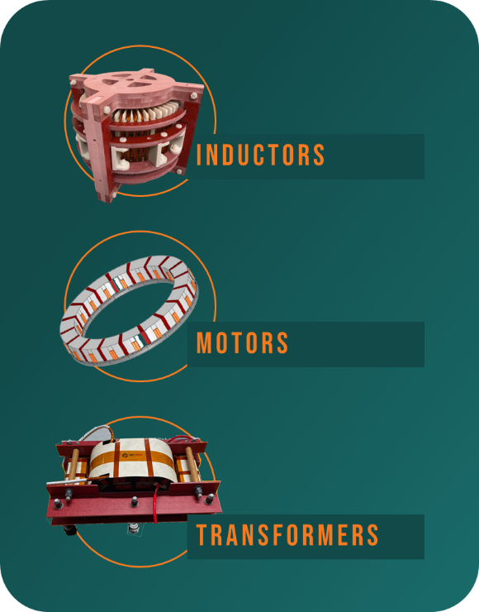




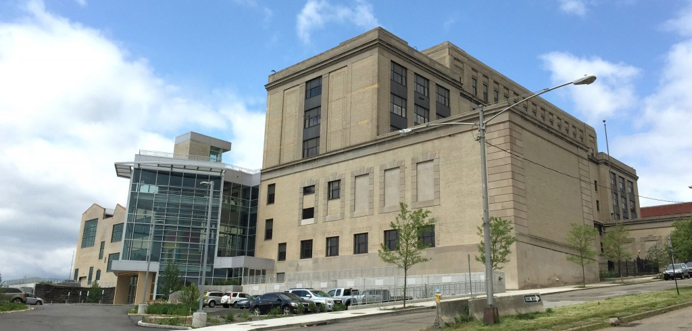
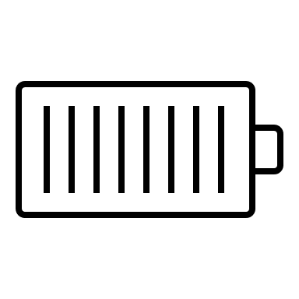
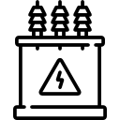
CorePOwer Magnetics - Snapshot
Formed: June 2020
Spin-Out from Carnegie Mellon University
>20 Granted or Pending Patents
Location: Energy Innovation Center, Pittsburgh PA
Products
Sea
Air
Electric Vehicles
Road
Industrial / Heavy
Primary Markets
Power Grid
Power
Conditioning
Generators
Energy Storage Management
Transformers

Slide 3
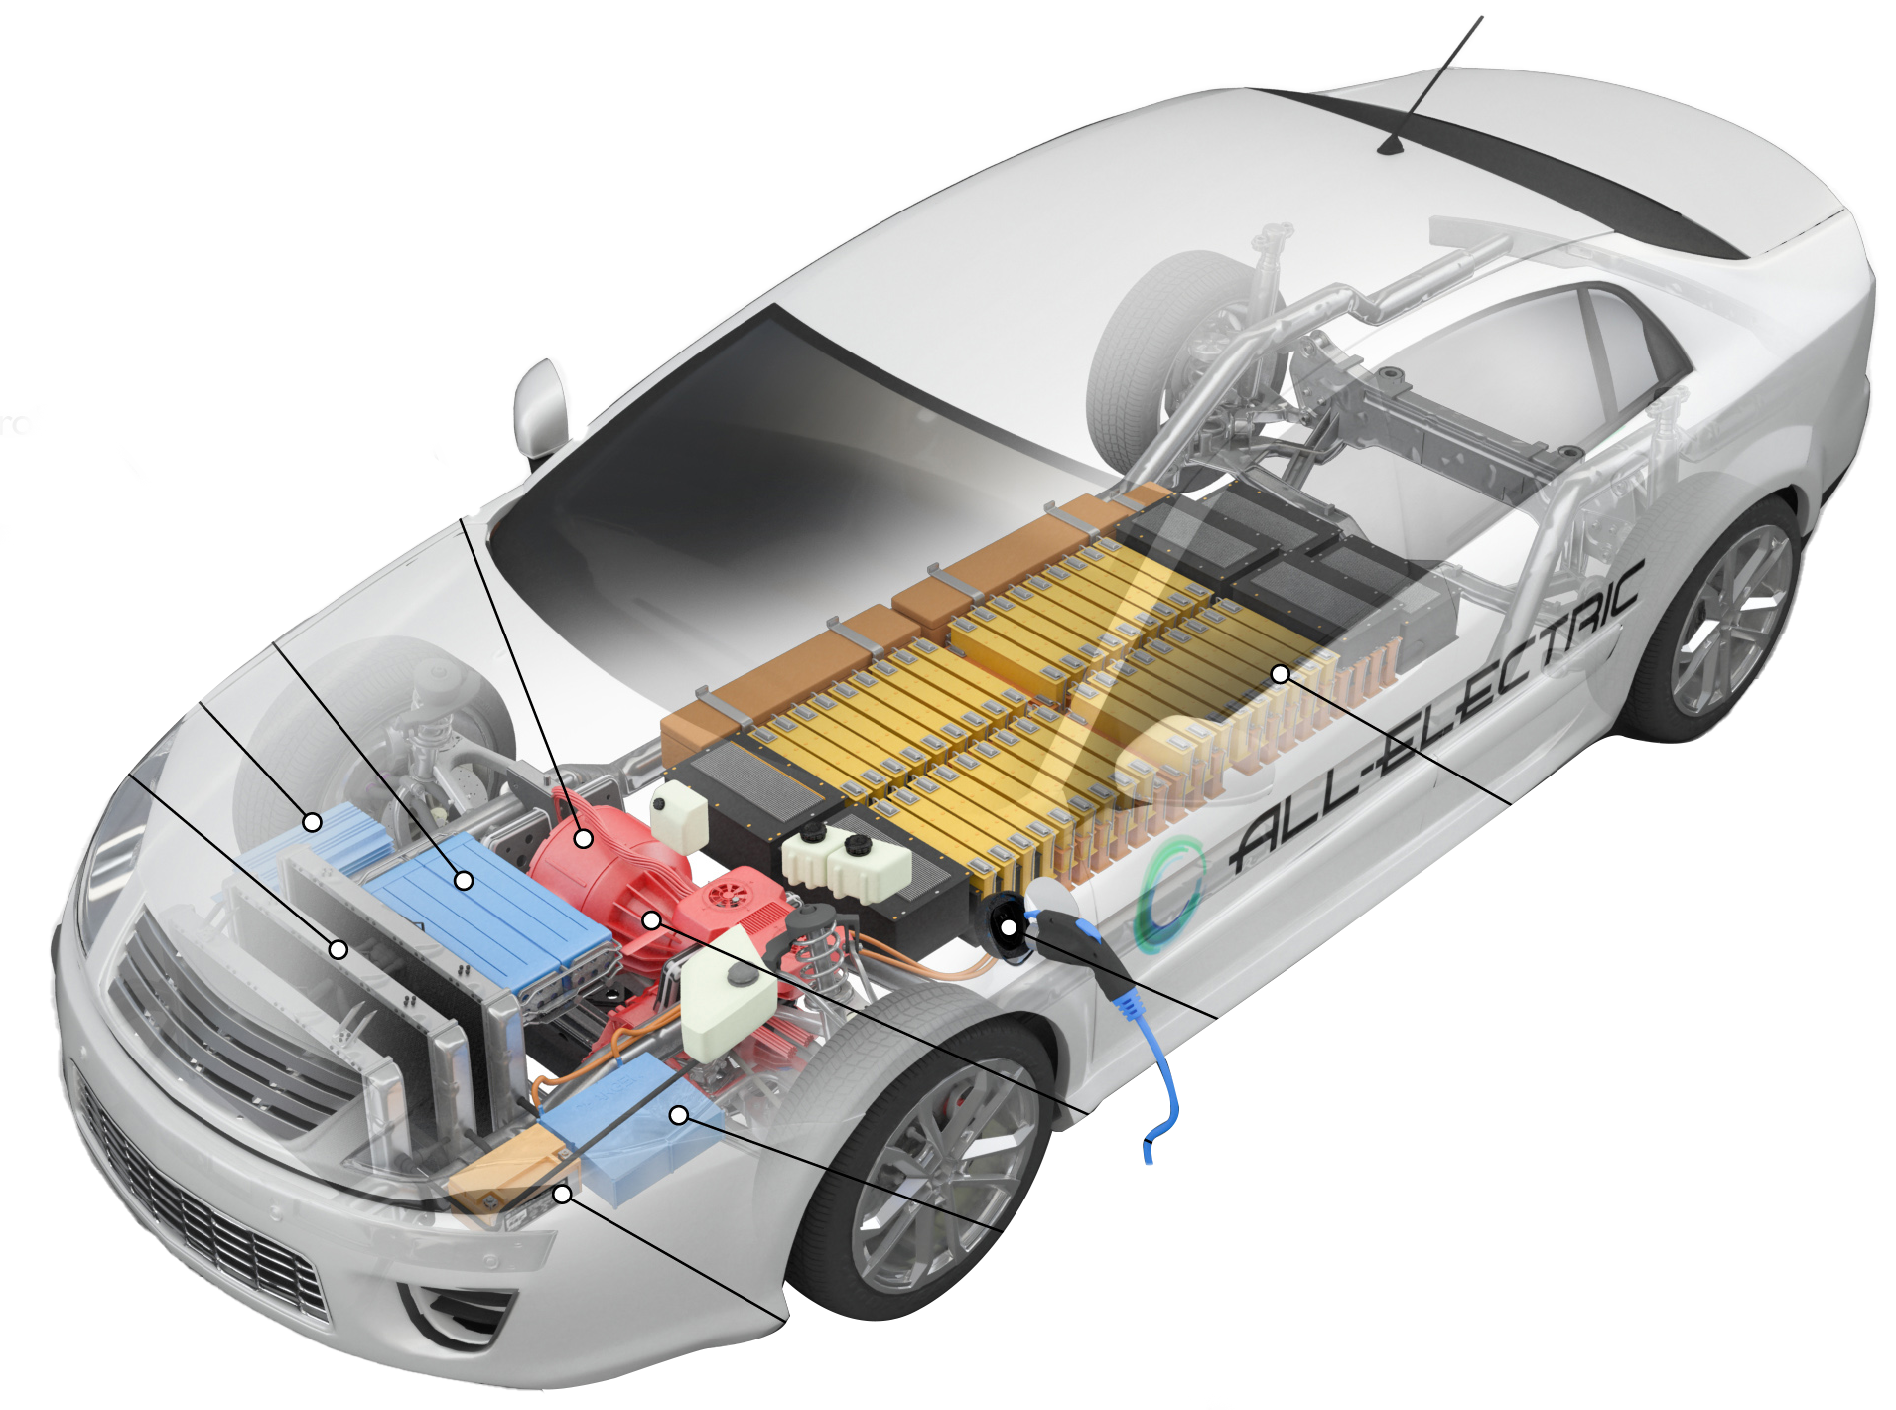
Battery Tech has improved DRAMATICALLY
44% of EV drive-train
Magnetic Components
—YET Magnetics Remain MOSTLY UNCHANGED:
comprised of magnetic components
Electric Traction Motor
Power Electronics Controller
DC/DC Converter
Thermal System (cooling)
Traction Battery Pack
Bulkiest + most-inefficient parts of the drive chain.
BATTERY
Charge Port
POWER
ELECTRONICS
Stalling Progress
Increasing Costs
Weighing down EV’s
Negating Battery Improvements
Transmission
MOTOR
Onboard Charger
Battery (aux)

Slide 4
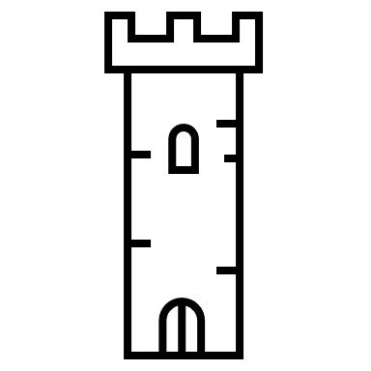



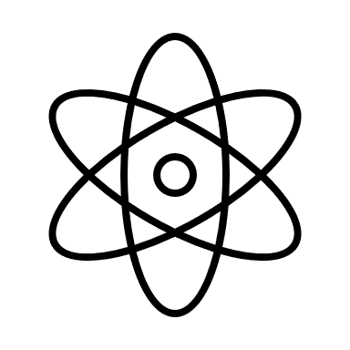
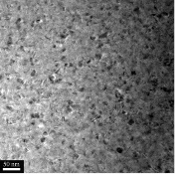
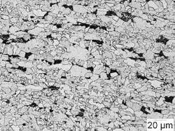
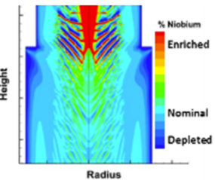
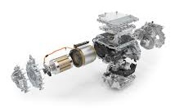
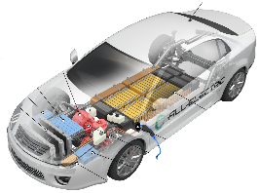
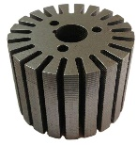
Supply chain and Engineering disciplines Align with the length scales of Design
Materials Companies
Tier 1s and OEMs
Quantum
Atomistic
Moat of Misunderstanding
Part
Assembly
System
Nano
Micro
Meso
Macro
LENGTH SCALE

Slide 5


Disrupt the Supply Chain to fully take Advantage of Advanced Design Techniques
Materials Expertise and Manufacturing Scope
Component Expertise and Manufacturing Scope
Quantum
Atomistic
Part
Assembly
System
Nano
Micro
Meso
Macro
LENGTH SCALE

Slide 6
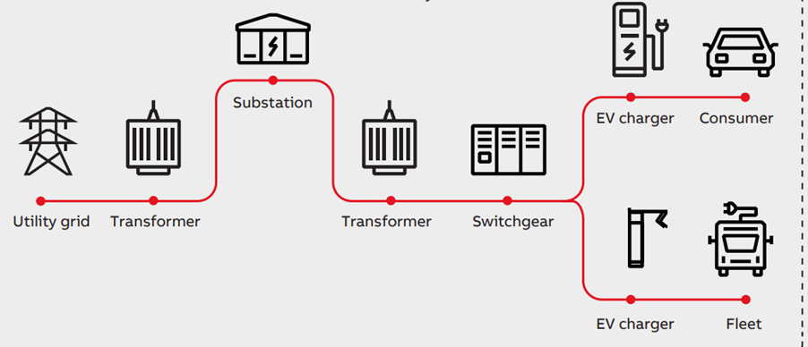
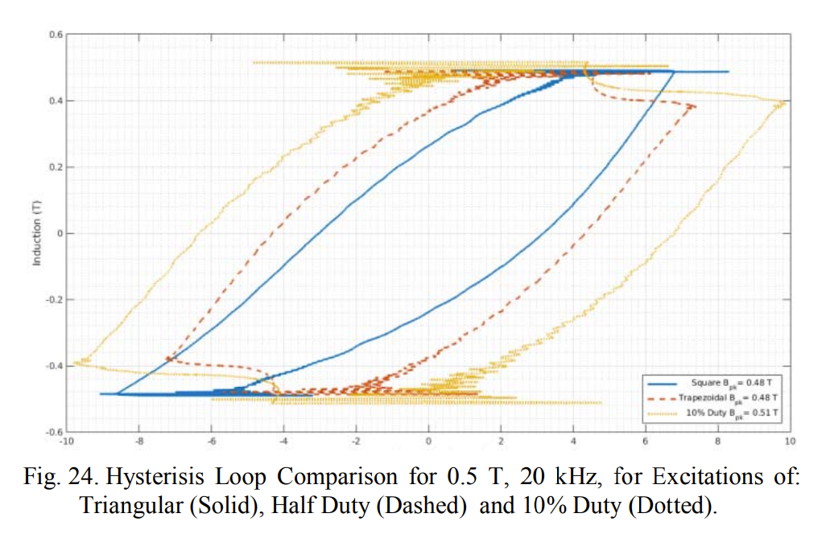
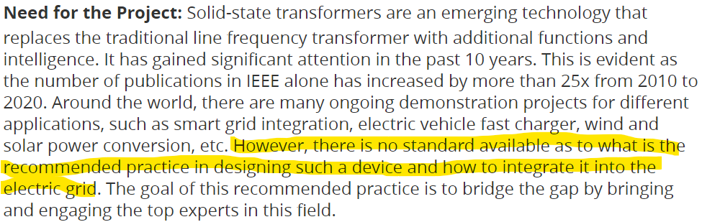
Industry Challenges
Perception that nanocrystalline is only FeSiBNbCu
Industry standards development needed at material through system level for nanocrystalline applications
New opportunities
New Challenges
Beddingfield et. al 10.1109/ECCE.2017.8095816
IEEE Power Electronics Society/Standards Committee (PEL/SC) - P3105
Notes:
The nanocrystalline alloys are one of the few alloys classes where the name is associated with basically one commercial alloy. Because of this, it immediately limits the thought process at the design stage of what these alloys are capable of. As much we materials scientists want to simplify

